Slide 1

iPhone App Development
Lecture #1
October 4, 2011

Slide 2
Prerequisites
Has nothing to do with your prior experience!
Programming experience is recommended, but not required
Things you need:
Intel Based Mac
Snow Leopard or Lion (Mac OS X 10.6 or 10.7)

Slide 3
Goals
To be able to write your own apps
To understand sample code and teach yourself the multitudes of frameworks iOS and Cocoa contains
I cannot teach you all of them!
Most importantly: fluency in Objective-C and Cocoa foundations, so you can begin to write your own apps that focus on what you’re interested in

Slide 4

Things you will need
XCode 4.2/iOS 5
Can use Xcode 4.0/iOS 4.3, but I will be teaching through iOS 5
Can download from http://www.developer.apple.com
Apple Documentation
http://www.developer.apple.com/library/ios
Also comes with XCode
Apple Developers Program
University Developers Program

Slide 5
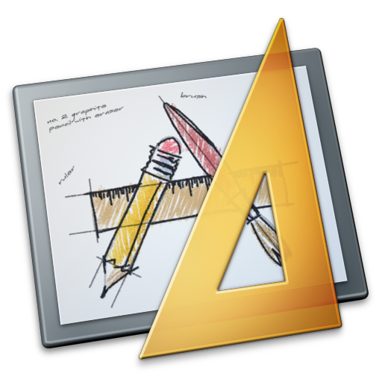
Syllabus (Tentative)
MVC Paradigm
Objective-C
XCode/Interface Builder/Debugger
Foundation Framework
Memory Management
Protocols/Delegates
Navigation Controllers
Table Views
Tab Bars
After Fall Break:
Persistence/Settings Bundles
Core Data
Core Location/MapKit
WebKit
Various Other Miscellany

Slide 6
Today
Model-View-Controller Programming Paradigm
Review of Object Oriented Programming
Target/Action and “outlets”
Objective-C
Calculator Demo

Slide 7
Model-View-Controller
Controller
Model
View

Slide 8
Model
What your application is, but not how it looks
View
User interface. Views do not own the data they display
Controller
Middleman between the model and the view.
Controls how the view looks based on the model
Interprets model data and formats for the view

Slide 9
Model-View-Controller
Controller
MODEL AND VIEW NEVER TALK DIRECTLY TO ONE ANOTHER
Model
View

Slide 10
Model-View-Controller
Controller
Controller tells the view how and what to display. This is called an outlet.
Model
View

Slide 11
Model-View-Controller
Controller
Controller updates the model based on user interaction with the view. Also retrieves data from the model
Controller tells the view how and what to display
Model
View

Slide 12
Model-View-Controller
Controller
“Blind communication”. Controller sets target on itself, view knows to send information to the target, but doesn’t know what the target is or to what it belongs
Model
View

Slide 13
Object Oriented Programming
Definition: Programming using data structures consisting of fields and methods, and having them interact with one another as distinct entities
Encapsulation – Restricting access to an object’s data by external objects
Inheritance – Subclasses inherit the properties of their superclasses
Polymorphism – Giving a method more than one form. Subclasses can override the methods of their superclasses
iOS is very strongly object oriented.
Everything is a subclass of NSObject
Oftentimes you will subclass existing objects (table cells, buttons, etc.)

Slide 14
Pointers
A pointer is a construct that points to a memory address.
Example:
BankAccount bank = new BankAccount();
BankAccount *bankPointer = &bank;
bankPointer actually points to the memory address where our bank object lives
Allows for quick access and reference, no need to copy.
If we print bankPointer, we will actually get its memory address
To dereference pointer:
BankAccount bank2 = *bankPointer;
Now bank2 has the same value as bank

Slide 15
Objects in iOS
ALL OBJECTS MUST BE POINTERS IN IOS
Example:
NSString *string = @”Hello World”;
UIButton *button = [[UIButton alloc] init];
There are some C structs as well, which are not pointers because they’re not technically objects
id
One exception to the rule, it is already a pointer.
Therefore, when you define it, you need not use an asterisk
id string = @”Hello World”;
id button = [[UIButton alloc] init];

Slide 16

Target/Action
Action
Controller
View
Outlet
This is really important when using Interface Builder within XCode
Will show in demo!

Slide 17
Hello World!

